Slide 1
Quarterly HR Community Meeting
Human Resources Administration
November 19, 2019

Slide 2
Quarterly HR Community Meeting
AGENDA
November 19, 2019, 10:00am – 12:00pm
Room 1816, 18th Floor, West Tower
Welcome Al Howell
Human Trafficking Prevention Training Al Howell
Fair Labor Standards Act Changes Latatia West
Tonia Nelson
Georgia Stable Lynne Riley
                State Treasurer
Meeting Wrap-up Al Howell
Join us for an informal HR Community lunch in the cafeteria following the meeting.

Slide 3
Human Trafficking Prevention Training
Al Howell

Slide 4
Human Trafficking Prevention Training
First Lady spoke at May HR Community Meeting
Video from First Family of Georgia introduces training currently being developed
Full training video will debut at Grace Commission on August 29
First Lady will narrate the training video
Anticipate training will be made available to agencies in January 2020
Encouraged but not mandatory
Will track number of employees trained
Same delivery method as preventing sexual harassment training

Slide 5
Fair Labor Standards Act Changes
Latatia West
Tonia Nelson

Slide 6
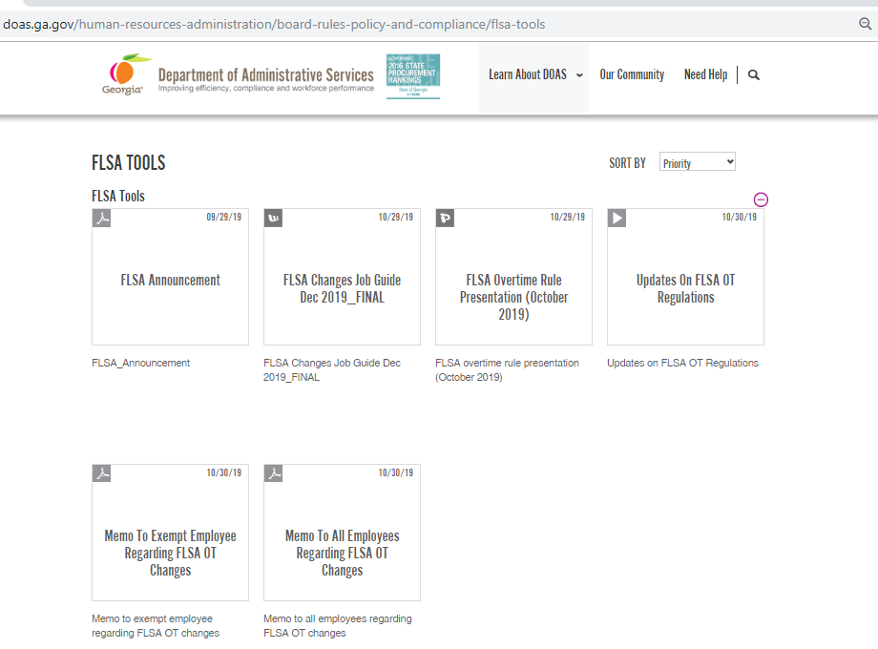
FLSA Tools

Slide 7

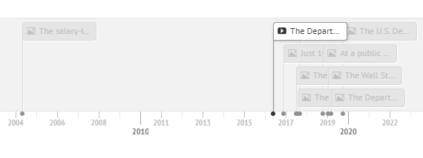
FLSA Timeline from 2016 - current
Timeline taken from www.shrm.org and is titled “Overtime Rule History.”
Notes:
This timeline shows the flurry of activity that has occurred since about 2016. As many of you are aware, the USDOL, issued notice of its final rule on Fair Labor Standards Act (FLSA) on September 24, 2019. The final rule becomes effective on January 1, 2020, meaning there’s about little over a month remaining to make the necessary changes to ensure compliance.
Notice of the rule change didn’t come out of

Slide 8
Question #1 regarding FLSA OT Updates
When is the last time that FLSA final rule updates were implemented?
1938
2004
2016

Slide 9
Question #2 regarding FLSA OT Updates
Which of the three tests have been changed under the new FLSA Overtime Rule?
Salary basis test
Duties test
Salary threshold test
None of the above
All three have changed

Slide 10
FLSA Overtime Updates
  To be exempt from overtime:
  All three prongs must be met to be exempt from overtime.
Paid on salary basis
Satisfy “duties test”
Meet salary threshold

Slide 11
FLSA Overtime Updates
  NOTE:
  Certain professional employees are not subject to the salary basis or salary threshold.
  The USDOL receives authority through the FLSA to update the regulations on overtime exemptions.

Slide 12
Question #3 regarding FLSA OT Updates
What is the new salary threshold under the new FLSA OT Rule?
$16,300
$23,600
$35,568
$47,616

Slide 13
FLSA Overtime Updates
New Regulations Effective January 1, 2020
Salary threshold will be set at the 20th percentile of all full-time employees
Salary threshold increases from _______ to _________.

Slide 14
Question #4 regarding FLSA OT Updates
What is the new salary threshold for highly compensated employees under the new FLSA OT Rule?
$107,432
$100,000
$105,000
$95,568

Slide 15
FLSA Overtime Updates
New Regulations Effective January 1, 2020
Highly compensated employee exemptions salary threshold increases from $_____/year to $______/year
DOL to review salary thresholds on a regular bbasis; no automatic adjustments

Slide 16
Question #5 regarding FLSA OT Updates
For highly compensated employees, non-discretionary bonuses, incentive payments and commissions can be used to calculate up to ____% of the standard threshold
3%
5%
10%
20%
33%

Slide 17
FLSA Overtime Updates
New Regulations Effective January 1, 2020
Non-discretionary bonuses, incentive payments, and commissions (paid at least annually) can be used to calculate up to ___% of the standard threshold
Catch-up payment permitted at the end of the 5252-week period

Slide 18
FLSA Overtime Updates
New regulations do not:
Make changes to the salary basis prong
Make changes to the duties prong
Interesting Facts:
Over 116,000 comments were received by USDOL, which also conducted “listening sessions” in several cities prior to issuing the proposed rule.

Slide 19
FLSA Overtime Updates
  What should we do to prepare?
(1) Identify all employees who will be affected
    Currently classified as exempt
AND
    Earning less than $35,568 per year
Notes:
Changes in the regulations will require some agencies to reclassify a certain number of employees from exempt to nonexempt status if they currently have employees classified as exempt with annual salaries below the new salary threshold.
Reclassification will have several implications, including compensating these employees for overtime worked and tracking hours worked. We encourage agencies to take action now to prepare for the effective date of January 1, 2020. Agencies will not receive additional funding to manage any financial impact that arises due to changes in the FLSA regulations. Financial liabilities that must be managed within approved budgets include overtime pay, penalties, fees, or back pay.
Steps employers should take now – These steps were actually outlined in an advisory that went out in March of this year. At that time, the thinking was that the salary threshold would be $35,308, so there might be a minor difference in the positions identified and reviewed after agency receipt and review of the advisory back in March. I’ll still go over each step (which has been updated given the difference in salary threshold change from what was identified in March).
To help you prepare, we recommend the following steps:
Step 1) Identify all employees earning less than $35,568 per year that are currently classified as exempt. The information that Tonia will cover will assist with determining which positions these are.

Slide 20
FLSA Overtime Updates
  What should we do to prepare?
(2) Track hours for all employees identified to be reclassified as nonexempt
  Identify the number of hours that will be considered overtime
  Determine if the overtime hours can be managed to a minimum

Slide 21
FLSA Overtime Updates
  What should we do to prepare?
(3) Review current standards or policies that may need to be changed
  Use of agency-issued communication devices (laptops, cellphones, tablets, etc.)
  Telework policies or practices
  Policies on requirements for working overtime (over 40 hours per week)

Slide 22
FLSA Overtime Updates
  What should we do to prepare?
(4) Create a timeline for change management activities to ensure compliance with January 1, 2020 effective date.
  Develop a list of the changes and draft a plan for how your agency will respond
  Prepare early to ensure timely compliance
Here are system deadlines for State agencies:
  The system changes need to be made during the month of November 2019
  The effective date of the changes need to be between November 1, 2019 and November 30, 2019.

Slide 23
FLSA Overtime Updates
  What should we do to prepare?
(5) Prepare managers and supervisors
  Communicate with employees about the changes
  Answer employee questions
  Possibly reclassify some managers/supervisors

Slide 24

(5) Prepare managers and supervisors
http://doas.ga.gov/assets/Human%20Resources%20Administration/FLSA%20Tools/FLSA_Announcement.pdf

Slide 25
(5) Prepare managers and supervisors
http://doas.ga.gov/assets/Human%20Resources%20Administration/FLSA%20Tools/FLSA_Announcement.pdf

Slide 26
FLSA Overtime Updates
  What should we do to prepare?
(6) Communicate upcoming changes
  Determine communication techniques suitable for workforce, hours of business, and locations
  Consider how affected employees may perceive the changes
  Convey that changes are federal law mandates applying to all employers

Slide 27
Effects of FLSA Overtime Updates
Require reclassification of previously exempt employees to nonexempt status
Both exempt and nonexempt in same job
Potential to cause previously unexpected overtime
New monitoring responsibilities

Slide 28
FLSA Overtime Updates
Consequences of misclassifying an employee as exempt:
Back wages and overtime compensation owed
Attorney’s fees
Potential for class action
Additional penalties for willful violations

Slide 29
Agency experiences
Through communication with various agencies, focus since notification of the FLSA Final OT Rule updates has been on the following:
Impacted positions
Determining what the agency budget will allow
Determining how to handle both exempt and non-exempt employees in the same job
Ensuring proper classification of positions
Still moving forward despite being mindful of 2016

Slide 30

Managing comp time/overtime

Slide 31
Updating FLSA Status
System changes need to be made by agencies/entities in their HR/Payroll system during the month of November 2019 and complete the updates by November 30, 2019.
To assist with understanding the process of making position changes in TeamWorks HCM, see the job aid titled How to Make Required FLSA Changes.

Slide 32
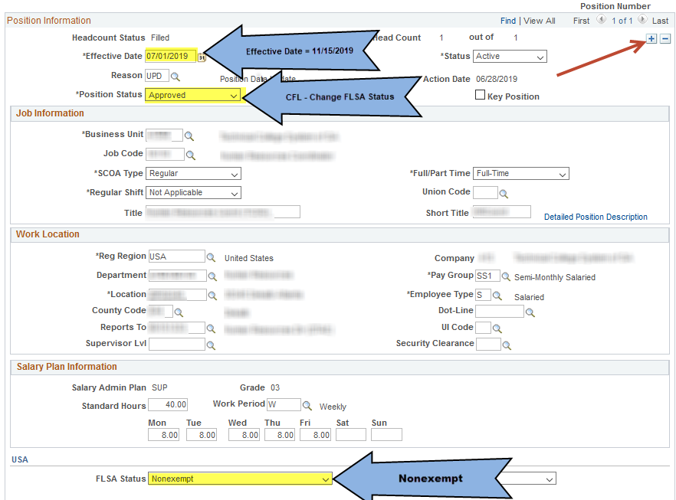
Updating FLSA Status

Slide 33
If in need of assistance with making system updates…
For TeamWorks HCM Support: | SAO TeamWorks HCM Customer Service Center (404) 657-3956 (888) 896-7771 HCM@sao.ga.gov
For policy or program questions: | DOAS HRA Contact Center (404) 656-2705 (877) 318-2772 Hra@doas.ga.gov

Slide 34
Georgia Stable
Lynne Riley
State Treasurer

Slide 35
Meeting Wrap-up
Al Howell

Slide 36
FY19 Performance Review Ratings Input
First day to begin updating Performance Rating Mass Entry pages | October 1, 2019
Last day to update Performance Rating Mass Entry pages Note: AGENCIES THAT MISS THE November 29 DEADLINE WILL BE REQUIRED TO MANUALLY ENTER EMPLOYEE REVIEW ROWS. | November 29, 2019
Employee review pages are updated by the mass entry program and processed in the nightly batch for the HCM Production database Note: No rows will be entered into Job Data for any employees since there is no financial impact at this time. | December 27, 2019
For more information, visit SAO’s website at:
https://sao.georgia.gov/human-capital-management/human-resources/performance-evaluation-rating-processing

Slide 37
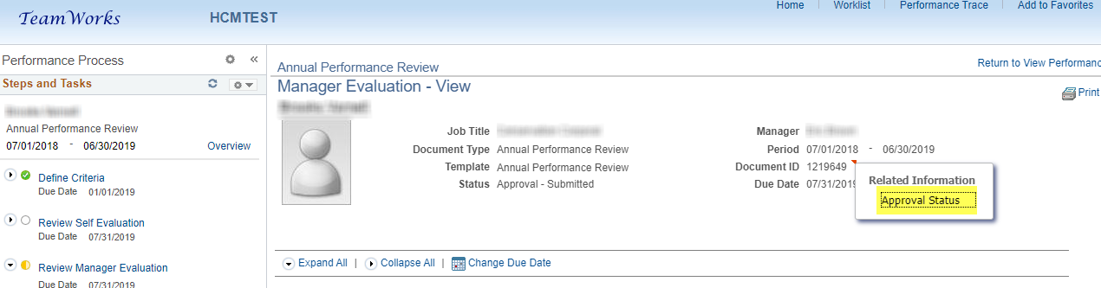
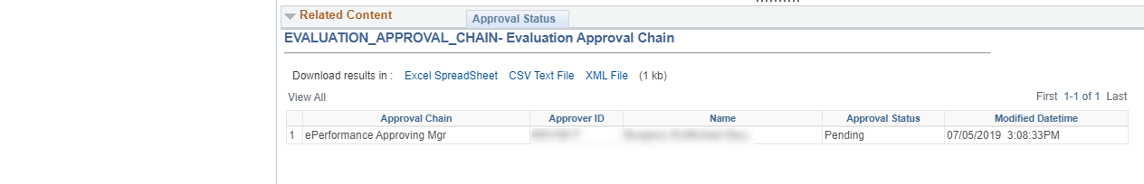
ePerformance Approval Status Display

Slide 38
2020 HR Community Meeting
Dates and Topics
Tuesday, February 18th
FMLA, ADA, and Worker’s Compensation
Tuesday, May 19th
TBD
Tuesday, August 18th
Benefits Update
Tuesday, November 10th
TBD

Slide 39
Other Upcoming HR Meetings
Tuesday, December 17th through Thursday, December 19th
CSPA Conference in Savannah

Slide 40
https://www.surveygizmo.com/s3/5319329/HR-Community-Meeting-Post-Session-Survey-11-19-19
http://team.georgia.gov/hra-newsletter/

Slide 41
404-463-7054

